Slide 1

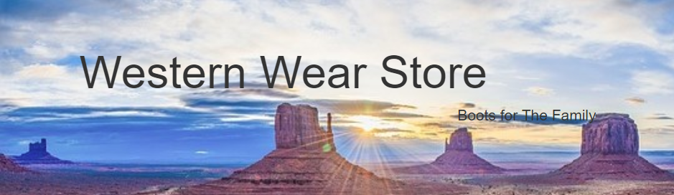
By: Monico Lara, Andrew nguyen, hunter newton, Daniyal Raoofi, Emmanuel Babson

Slide 2
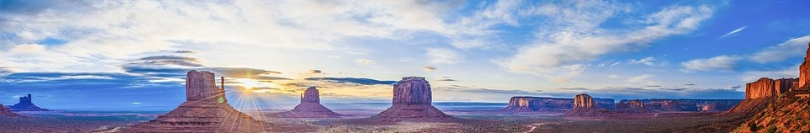
Webpage Concept
The Webpage is used for the buying of boots for all in the family.
Webpage includes:
Navigation Bar(Home, Men’s, Women’s, Juvenile's, and Toddler’s/Newborns)
The Home page shows all the best selling shows from each of the categories while if you click the men's/women's tab it will show you specifically their shows.
Each page includes the item name, item Picture, and a way too enlarge the Picture to view to better
There is also an about the editors page to the right where is has the members of the group with their pictures and a link to each of their own personal webpages

Slide 3
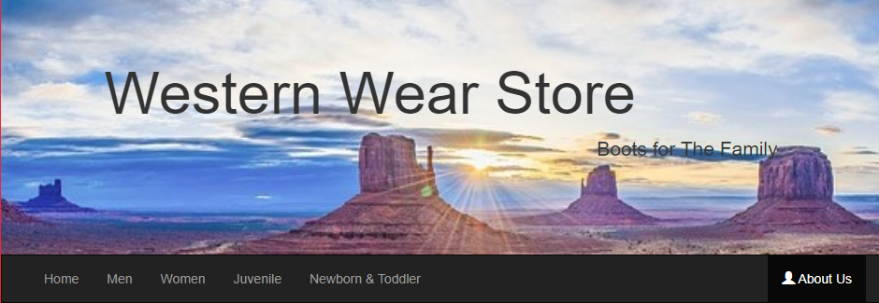
Banner & Navigation Bar
<nav class="navbar navbar-inverse">
<div class="container-fluid">
<div class="navbar-header">
<button type="button" class="navbar-toggle" data-toggle="collapse" data-target="#myNavbar">
<span class="icon-bar"></span>
<span class="icon-bar"></span>
<span class="icon-bar"></span>
</button>
<!-- <a class="navbar-brand" href="#">Logo</a> -->
</div>
<div class="collapse navbar-collapse" id="myNavbar">
<ul class="nav navbar-nav">
<li class="active"><a href="WebDevProject.html">Home</a></li>
<li><a href="Men.html">Men</a></li>
<li><a href="Women.html">Women</a></li>
<li><a href="Juvenile.html">Juvenile</a></li>
<li><a href="NewbornToddler.html">Newborn & Toddler</a></li>
</ul>
<ul class="nav navbar-nav navbar-right">
<li><a href="about.html"><span class="glyphicon glyphicon-user"></span> About Us</a></li>
</ul>
</div>
</div>
</nav>
<div class="jumbotron">
<div class="container text-center">
<div>
<!-- <h1 class="text-left" >Western Wear Store</h1>
<p class="text-right">Boots for The Family</p> -->
<h1 class="text-left">Western Wear Store</h1>
<p class="text-right">Boots for The Family</p>
</div>

Slide 4
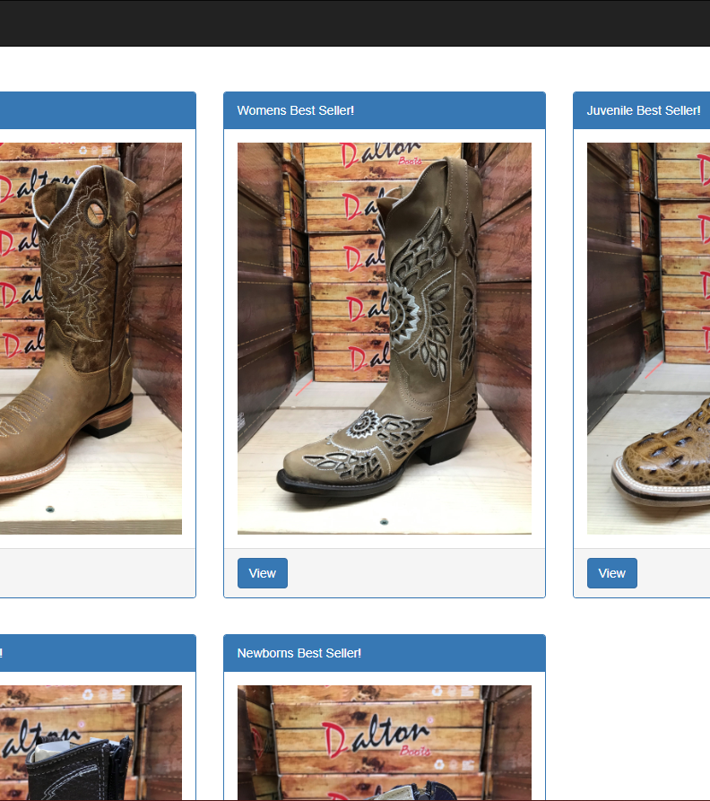
Home Page/Best Sellers
<form action="./PHP/item_display.php" method="post">
<div class="container">
<div class="row">
<div class="col-sm-4 panel1">
<div class="panel panel-primary">
<div class="panel-heading">Mens Best Seller!</div>
<div class="panel-body"><img class="img-responsive" src="img/Pato_Tang.JPG" class="center" alt="Pato Tang"></div>
<div class="panel-footer">
<!-- This button post to PHP -->
<button type="submit" name="btn" id="test" class="btn btn-primary b1" value="1">View</button><br/></div>
</div>
</div>
<div class="col-sm-4 pon2">
<div class="panel panel-primary">
<div class="panel-heading">Womens Best Seller!</div>
<div class="panel-body"><img class="img-responsive" src="img/Crystal_Flower.JPG" class="center" alt="Crystal Flower"></div>
<div class="panel-footer">
<!-- This button post to PHP -->
<button type="submit" name="btn" id="test" class="btn btn-primary b1" value="7">View</button><br/>
</div>
</div>
</div>

Slide 5
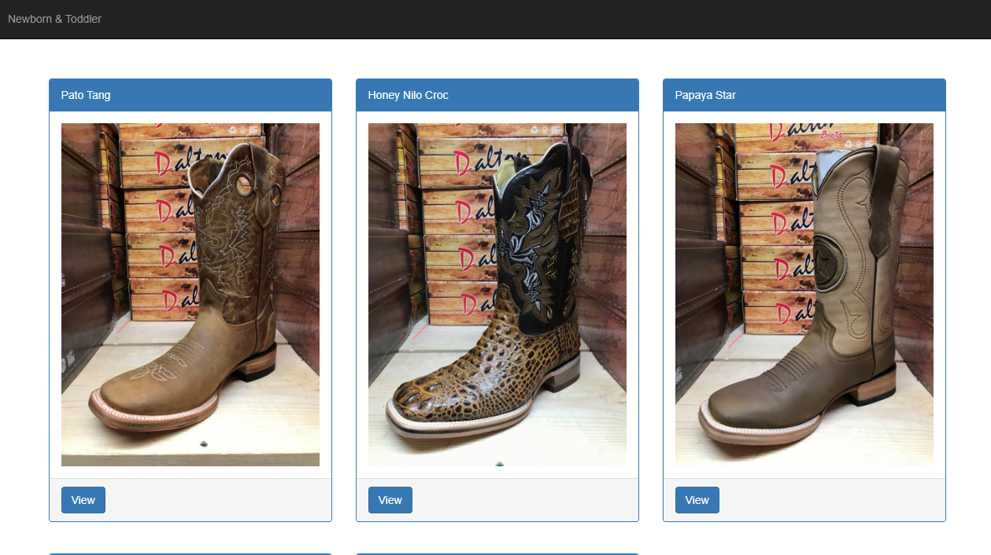
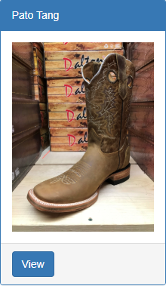
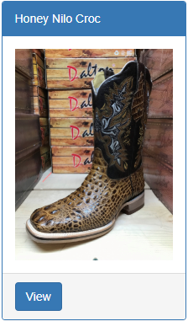
Different Tabs (Men’s Boot’s)
<form action="./PHP/item_display.php" method="post">
<div class="container">
<div class="row">
<div class="col-sm-4">
<div class="panel panel-primary">
<div class="panel-heading">Pato Tang</div>
<div class="panel-body"><img class="img-responsive" src="img/Pato_Tang.JPG" class="center" alt="Pato Tang"></div>
<div class="panel-footer">
<!-- This button post to PHP -->
<button type="submit" name="btn" id="test" class="btn btn-primary b1" value="1">View</button><br/>
</div>
</div>
</div>
<div class="col-sm-4">
<div class="panel panel-primary">
<div class="panel-heading">Honey Nilo Croc</div>
<div class="panel-body"><img class="img-responsive" src="img/HoneyCroc.JPG" class="center" alt="Honey Croc"></div>
<div class="panel-footer">
<!-- This button post to PHP -->
<button type="submit" name="btn" id="test" class="btn btn-primary b1" value="2">View</button><br/>
</div>
</div>
</div>

Slide 6
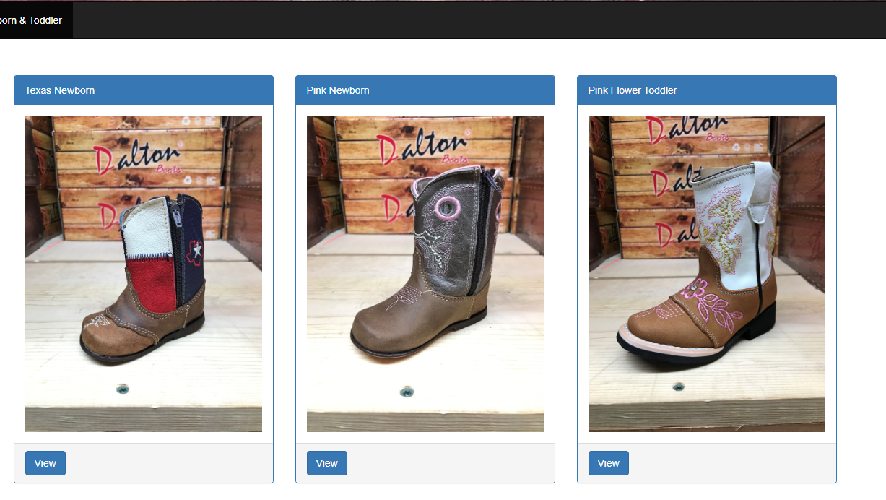
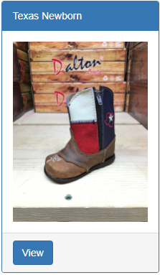
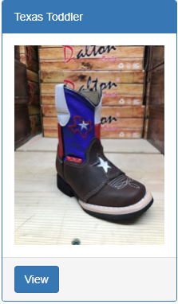
Different Tabs (Newborn & Toddler)
<div class="row">
<div class="col-sm-4">
<div class="panel panel-primary">
<div class="panel-heading">Texas Newborn</div>
<div class="panel-body"><img class="img-responsive" src="img/Texas_Newborn.JPG" class="center" alt="Texas Newborn"></div>
<div class="panel-footer">
<!-- This button post to PHP -->
<button type="submit" name="btn" id="test" class="btn btn-primary b1" value="16">View</button><br/>
</div>
</div>
</div>
<div class="col-sm-4">
<div class="panel panel-primary">
<div class="panel-heading">Texas Toddler</div>
<div class="panel-body"><img class="img-responsive" src="img/Texas_Toddler.JPG" class="center" alt="Texas Toddler"></div>
<div class="panel-footer">
<!-- This button post to PHP -->
<button type="submit" name="btn" id="test" class="btn btn-primary b1" value="20">View</button><br/>
</div>
</div>
</div>
</div>
</div>

Slide 7
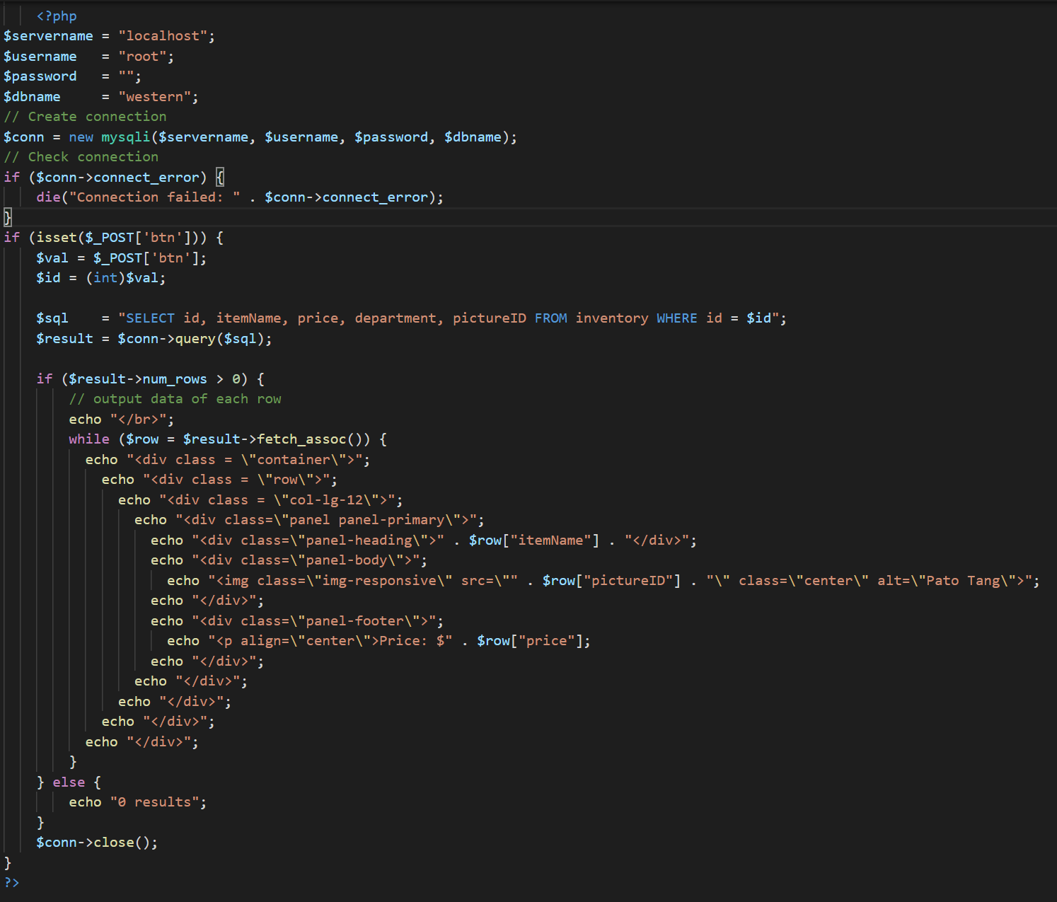
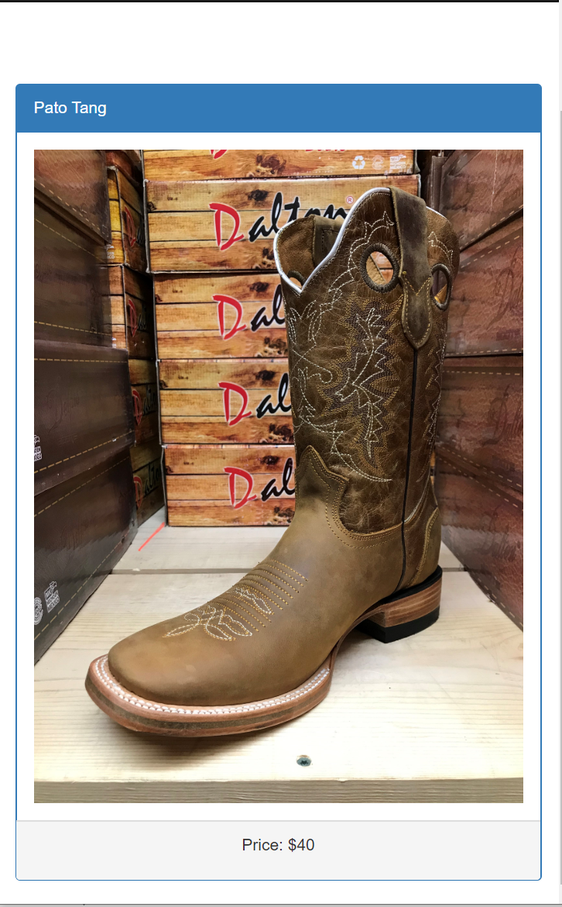
View item

Slide 8

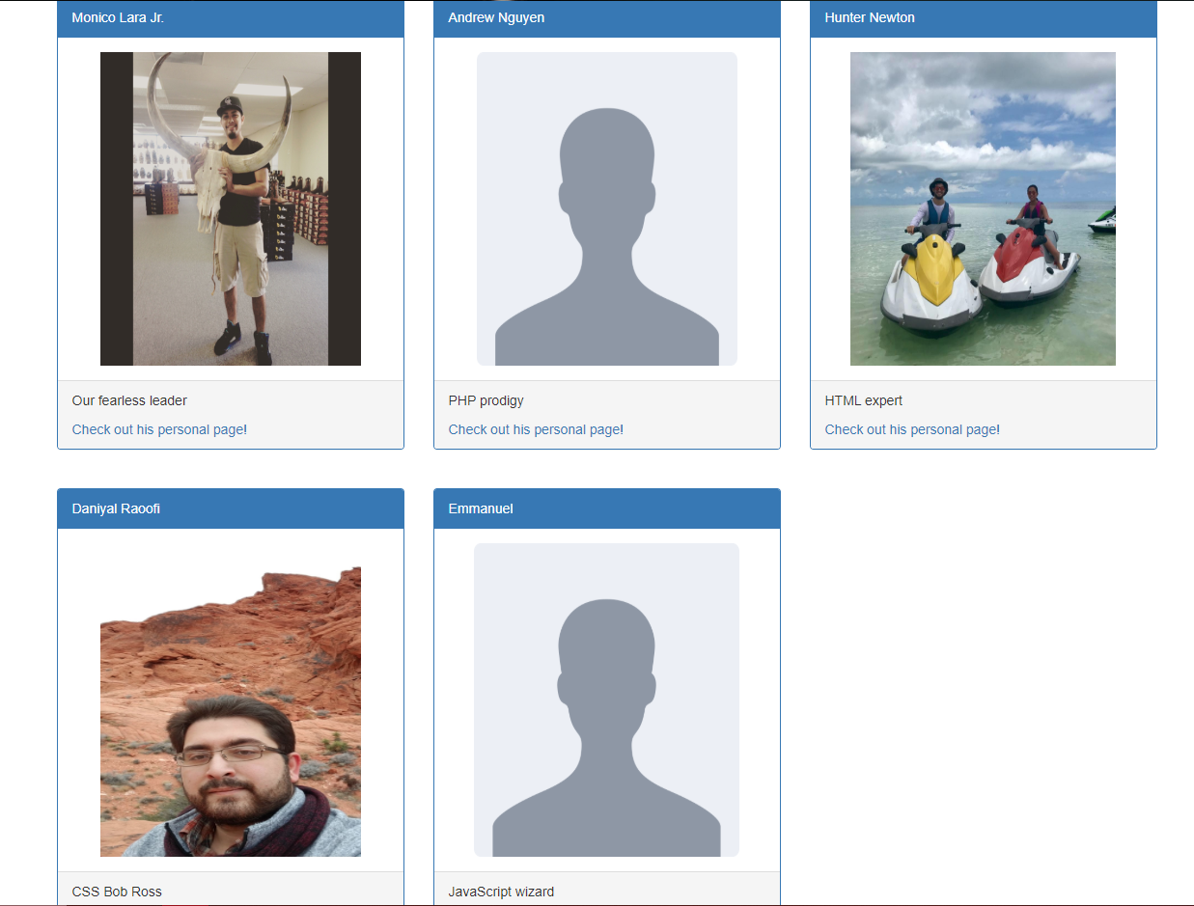



Personal Pages
<div class="container text-center">
<h1>Meet the dream team!</h1>
<br>
</div>
<div class="container">
<div class="row">
<div class="col-sm-4">
<div class="panel panel-primary">
<div class="panel-heading">Monico Lara Jr.</div>
<div class="panel-body"><img src="img/Monico.jpg" class="center" alt="Pato Tang" width="270" height="325"></div>
<div class="panel-footer">
<p>Our fearless leader</p>
<a href="about-pages/monico.html" target="_blank">Check out his personal page!</a></div>
</div>

Slide 9
Thank You

